Slide 1
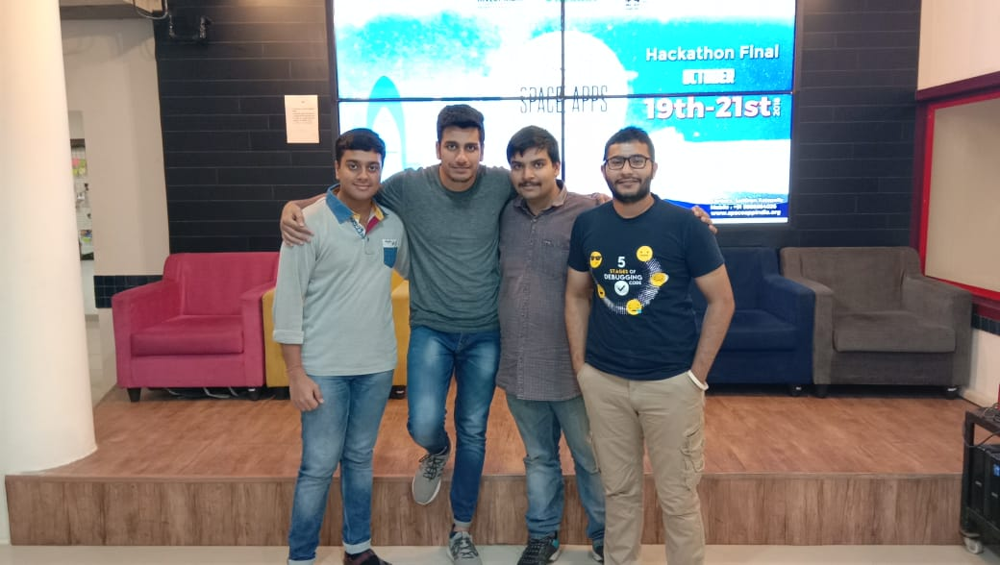
Team Name - SUDO
Team Members :
Rahul Aggarwal
Kapil Chaudhary
Puneet sharma
Sankalp chauhan

Slide 2
Problem Statement
Design an app that lets a user pick a location and learn about the parts of Earth's cryosphere that impact that location.
Potential Considerations:
Allow users to identify the nearest glacier, area of permafrost, snowpack, ice sheet, etc.
How far away is the nearest glacier? Ice sheet? Snow pack?
How does access to food, water, and shelter depend on the cryosphere? What about lifestyle or recreation?
How would life change in your location if that piece of the cryosphere changed? Disappeared?
How does the food in your location (crops, fish, etc.) depend on the cryosphere?
Design creative and interesting ways to display the data!

Slide 3
Unique Solution
We are developing a Cross-Platform Mobile Application for the both Targeted Users & General Audience.
Our Mobile Application works both for Offline & Online mode.
We let the User Choose a particular location and then we are providing the services like :
Finding nearest Glacier around that location.
Whether that region is Cryospheric or not.
Nearest food services to the User.
Change in LifeStyle due to change in Cryosphere.

Slide 4
Targeted User

Slide 5
Our Unique ISP
We have developed the whole algorithm for calculating the distance between N points in Real time . We have used Thorough Mathematics in this . We firstly map N points on the map according to the glacier points given by NASA DATA, Then according to Latitude and Longitudes of user picked location we calculated the distance for nearest Glacier .
Secondly For User Engagement We have Implemented An Augmented Reality Game Which works when multiple user are connected and they can throw ice bergs at their opponents and they will feel jerk if they get hit and lose point. So, We have used this for Better User Experience.

Slide 6
What We have Implemented :
Factors deciding Cryospheric Region :
First We retrieve the User Based Location and then get it’s Real time Temperature there, then we compare this temperature with the general temperature range of a Cryospherical Region; If the Temperature goes Below 5 degree Celcius we consider that region as Cryospherical.
However Our prediction can be Wrong as some deserts also go below 5 degree Celsius, So we have Deployed another factor Using Machine Learning
2. After getting the temperature we fetch the image of that location and our M.L model tries to Predict whether it’s a cryospherical Region or not.

Slide 7
What our M.L Model Does?
If the temperature Criteria fails to tell a region is Snowy or not, We have built a model that gets an image of the user picked location and tries to Predict if that Area is Snowy, has Glaciers ,Ice Sheets, Ice Bergs or not.
Note : Accuracy of the Model Trained : 92%
No. of Epochs : 30
Batch Size : 20
Dataset Size = 10000 Images
Based upon the 2 factors Above We conclude to our Final Output.

Slide 8
Technologies Used
Android Studio 3.2.0
Custom API’s Used
FireBase
Keras with Tensorflow as Backend

Slide 9
Business Model :
Build –Measure –Run Technology
Tier -1st Mobile Application for Arctic and Antarctica Region
Tier -2nd Cross Platform Application for User For Engagement in Application
Building with Blockchain , Implement Blockchain and Hyperledger Technology so that we can track each and every user and can fetch data easily and predict using that data using machine learning
Tier -3rd Scaling the Application

Slide 10
Thank You !!

